Slide 1
Nearest Province Finder
Jiaqi Zhang, Wenqiang Yang

Slide 2
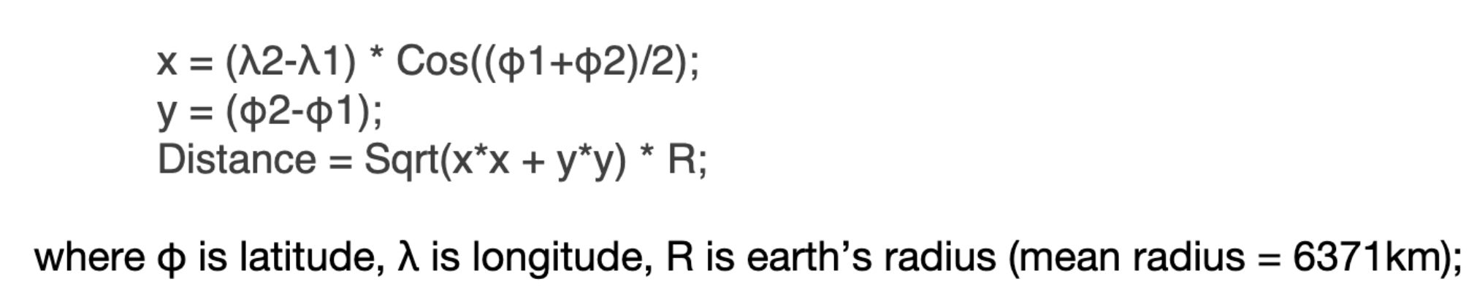
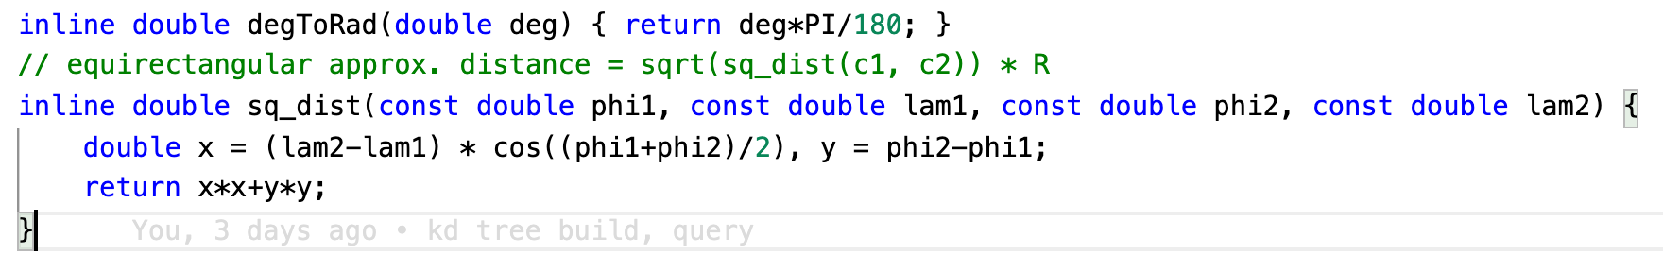
Equirectangular Approximation

Slide 3
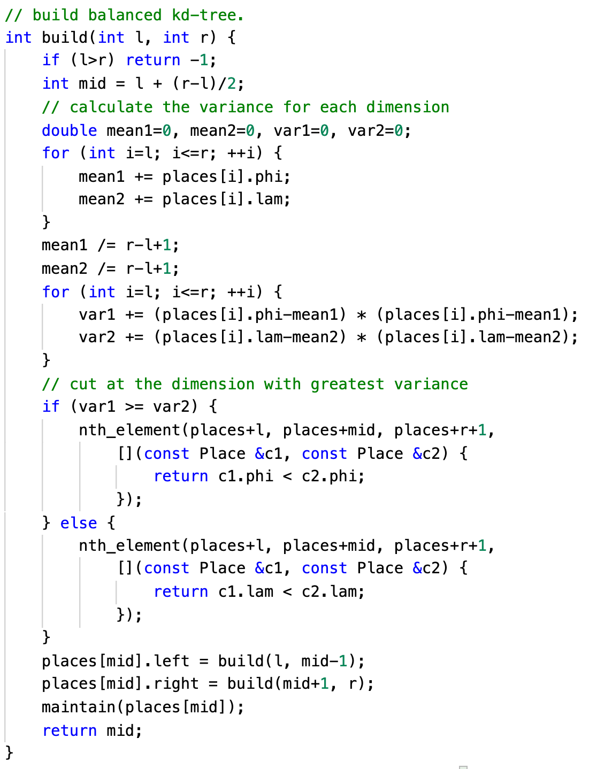
Build a K-d Tree
Build a K-d Tree recursively
Quick Select to make the tree balanced (using std::nth_element)
Cut at the dimension with the greatest variance to improve query performance
Maintain distance in post-order

Slide 4
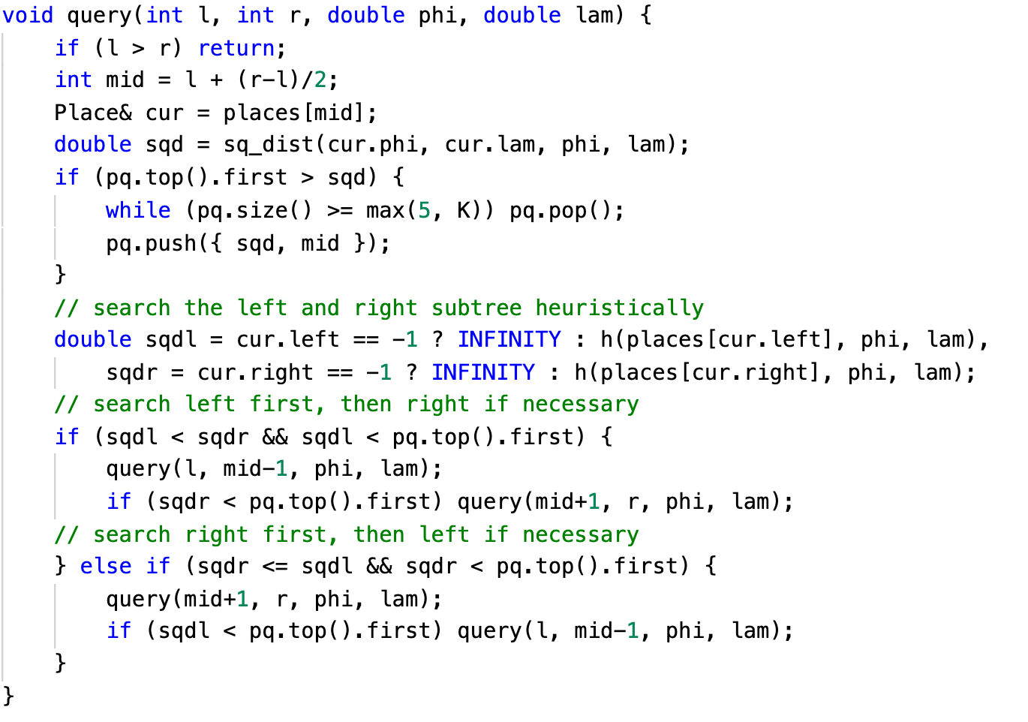
Query the K-d Tree
DFS with pruning
Heuristic Search for better performance ->Search the more promising subtree first h(x) calculates the minimum distance to the subtree
Max heap to store nearest K points // find the nearest K places for each query. pair: { distance, index } priority_queue<pair<double, int>, vector<pair<double, int> >, less<pair<double, int> > > pq;

Slide 5
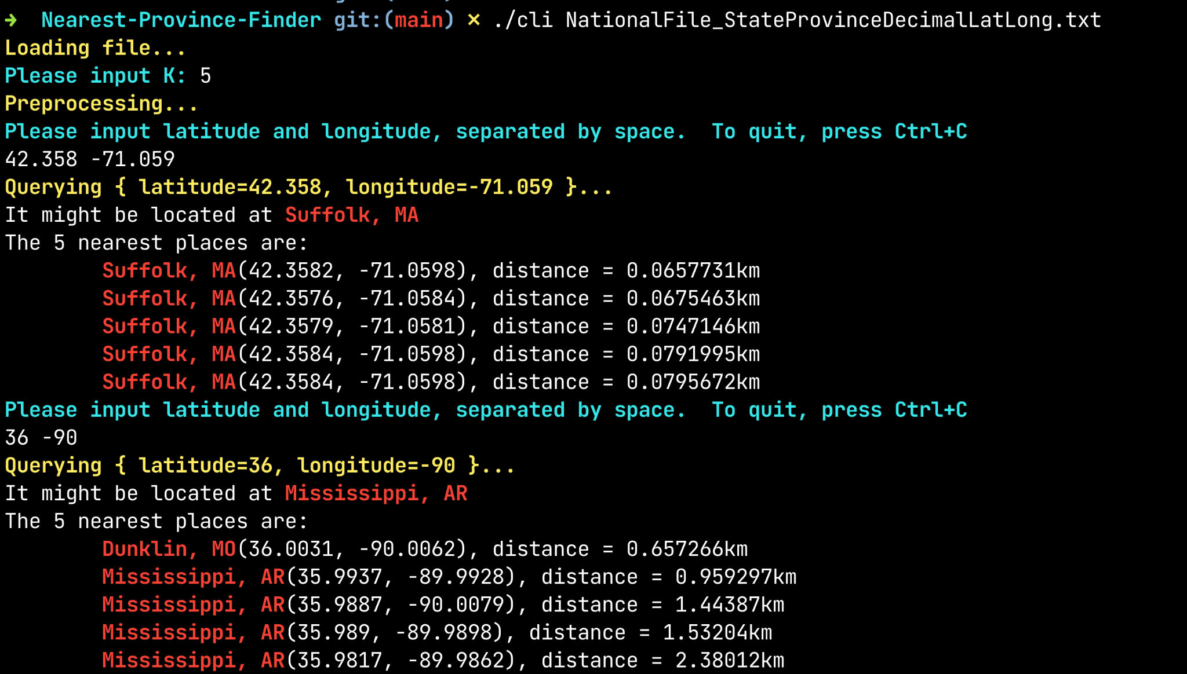
CLI

Slide 6
GUI Implementation
Google Maps Javascript API
Info window with Latitude and Longitude
Options to choose k from 1 to 10

Slide 7
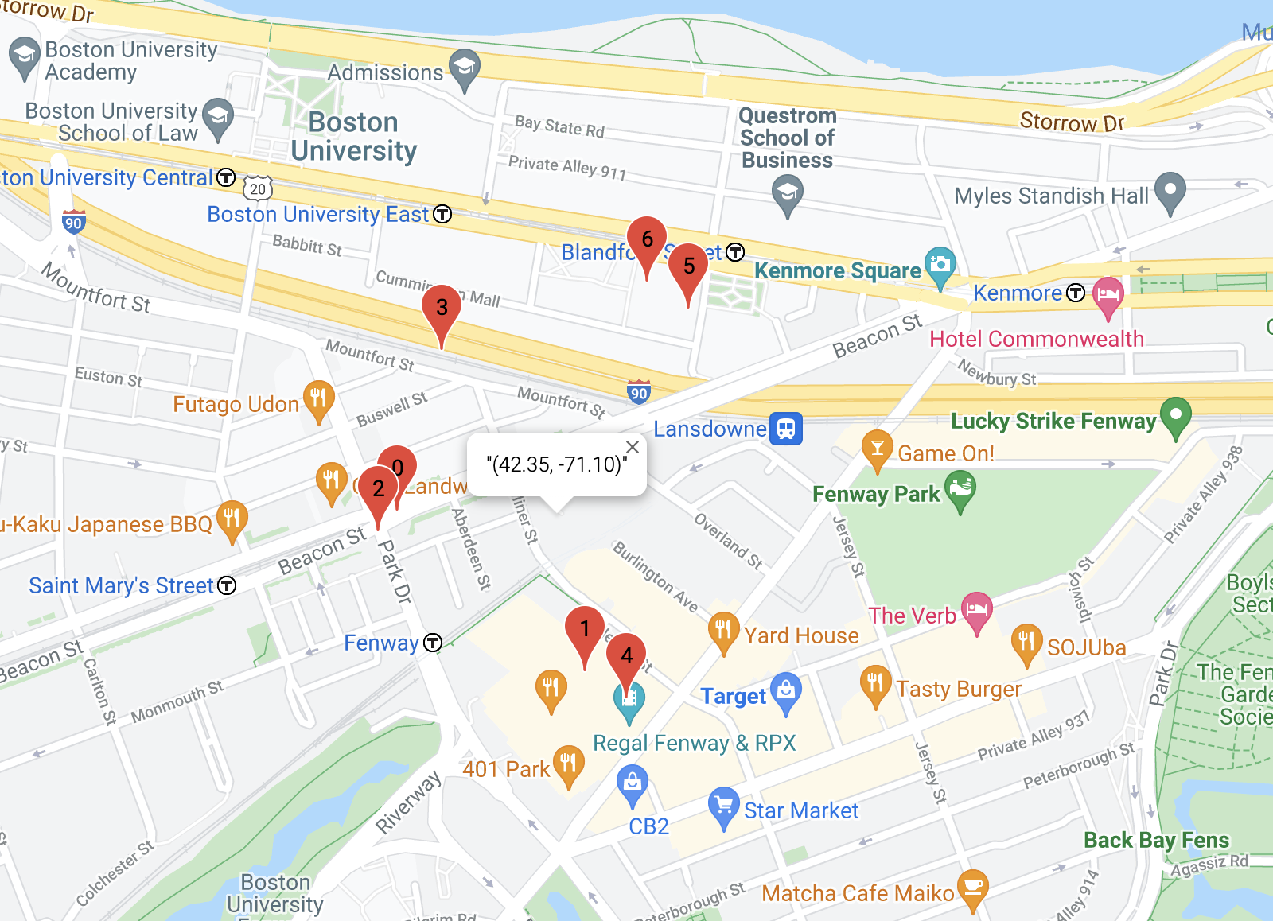
GUI

Slide 8
Thank you

